Slide 1


Spam Detection

Slide 2
As the meaning of the name suggests leading the way for everyone, I, Pravek Sharma shall guide you through the upcoming short presentation
In order to contact and know more about who I am ;
1. Email = pravek23@gmail.com

Slide 3


Slide 4
Spam is any kind of unwanted, unsolicited digital communication, often an email, that gets sent out in bulk. Spam is a huge waste of time and resources. Software providers invest resources creating email applications that try to filter most of the spam out. Consumers waste time sifting through whatever makes it past the spam filters. According to Oracle Dyn the total cost of spam, in terms of productivity, energy and technology, adds up to $130 billion. It’s an annoying and endless cycle.
It is amazingly IRRITATING!!!

Slide 5
The concepts that are widely misunderstood coagulated as one are :
Spam | Fraud | Duplicate
Irrelevant messages sent over the Internet, typically to a large number of users, for the purposes of advertising, phishing, spreading malware, etc. | Intentional deception to secure unfair or unlawful gain, or to deprive a victim of a legal right. | To make an exact copy of something. It is the copy of the original.

Slide 6
The Problem Statement:
To “detect” deceptive and truthful data from the dataset.
To detect is to be able to identify the parts and classifications.
Machine Learning models and algorithms can be implemented in order to
classify accordingly.
To make a user friendly and viewing easier, specific data is to be accessed
and utilized.

Slide 7

Dataset
Methodology:
Remove outliers
Remove useless columns
Fill Nan data
Create relatable values
Test & train Model
Finalizing Model
Predicting

Slide 8
The previous slide was somehow not precise and very clear on what exactly
is it that we have to do in order to get our Machine Learning Model all set
for the detection of the deceptive and truthful data in the dataset so procured.
That is exactly why we need to study and understand the technology and the
dataset used.
Dataset:
The Dataset precisely consists of 5 columns and several rows.
These columns consist the data
Deceptive/Truthful
Hotel
Polarity
Source
Text
This particular dataset showcases the texts which are truthful and deceptive
for various Hotels, given by various categories of people.

Slide 9
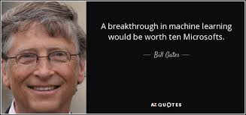
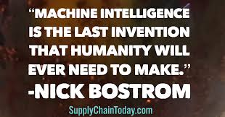
Technology:
The technology that has been used in order to detect the spam i.e.
the deceptive or truthful inputs by the customers is termed as
Machine Learning.
Machine Learning:
Machine learning (ML) is the study of computer algorithms that improve automatically through experience.

Slide 10
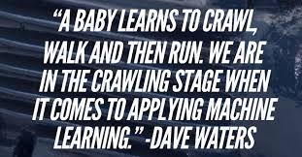
In order to use Machine Learning, we use Jupyter Notebook (python).
Jupytor:
Jupyter is a nonprofit organization created to "develop open-source software, open-standards, and services for interactive computing across dozens of programming languages". Spun-off from IPython in 2014 by Fernando Pérez, Project Jupyter supports execution environments in several dozen languages. Project Jupyter's name is a reference to the three core programming languages supported by Jupyter, which are Julia, Python and R, and also a homage to Galileo's notebooks recording the discovery of the moons of Jupiter.

Slide 11
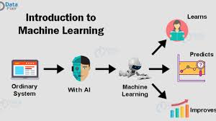
The environment and possibilities so provided by the AI proposed Jupyter (python) is used in applications of algorithms such as LableEncoder, DecisionTree, SVM, Logistic Regression which are also used in our ML model.

Slide 12
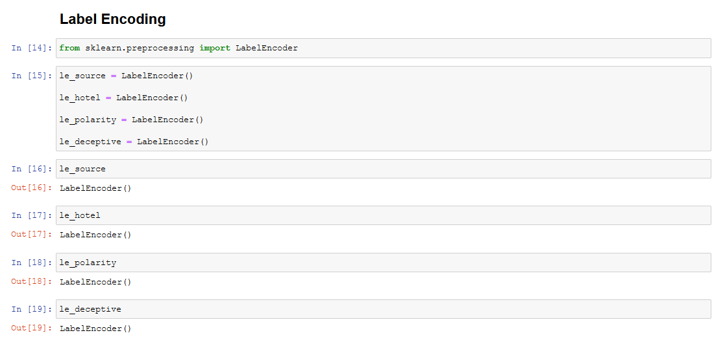
Label-Encoder:
It is an approach to encoding categorical values.
It refers to simply converting each value in a column to a number.
Label Encoding in Python can be achieved using Sklearn library.

Slide 13
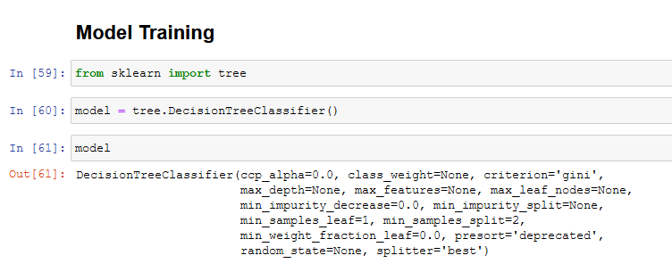
Decision Tree:
A decision support tool that uses a tree like model of decisions and thei5r
possible consequences.

Slide 14
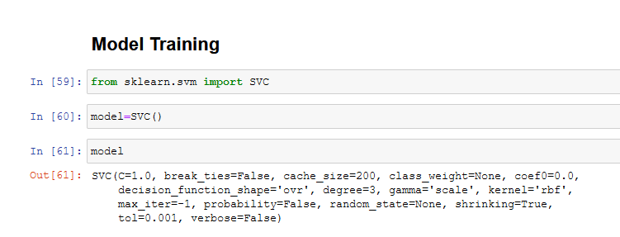
Support Vector Machine (SVM):
SVM is/are supervised learning models with associated learning
algorithms that analyze data used for classification and regression
analysis.

Slide 15
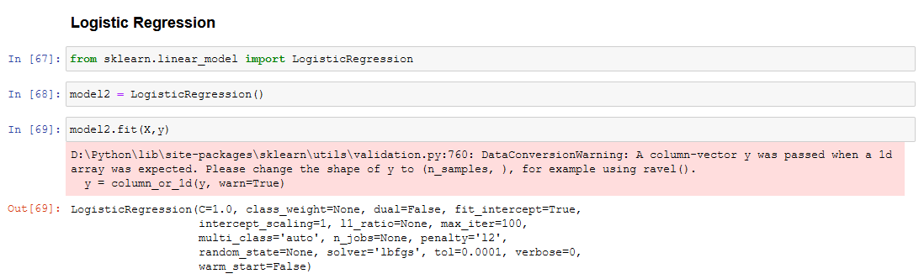
Logistic Regression:
Logistic regression is a statistical model that in its basic form uses a logistic function to model a binary dependent variable.
In a binary logistic regression model, the dependent variable has two levels. Outputs with more than two values are modeled by multinomial logistic regression and, if the multiple categories are ordered, by ordinal logistic regression.

Slide 16
Dataset:
The data set taken in the course of selection of the problem statement
consists of 5 columns and 3200 rows.
The Dataset so selected has been perfectly utilized by the models
in the project in order to depict the Spam/Non-spam or so to say
Truthful/Deceptive data entries.
It has no missing or Nan values, i.e. it is a clean dataset.
The relevant attributes are the entries in hotel, polarity and source
columns.

Slide 17
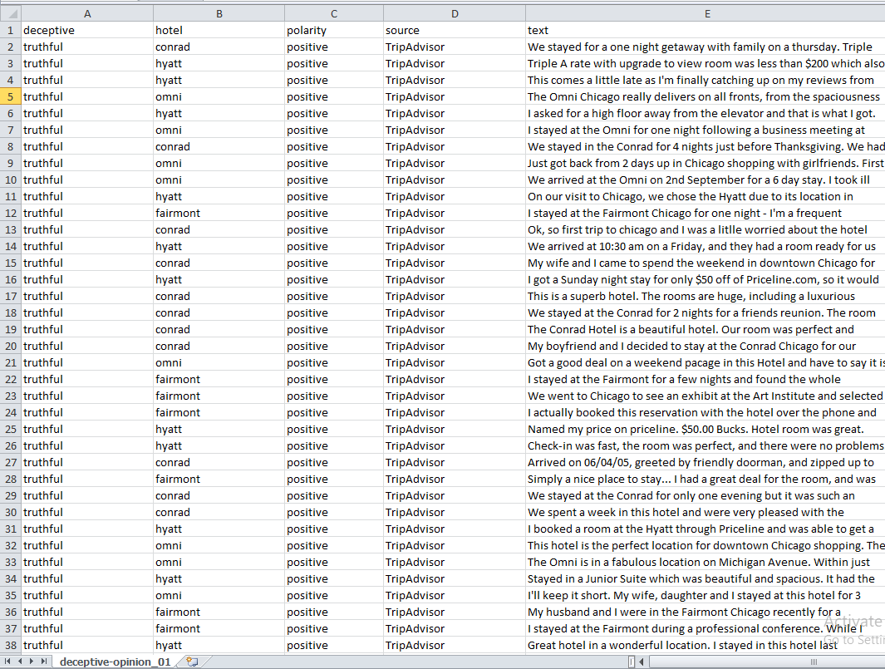

Slide 18
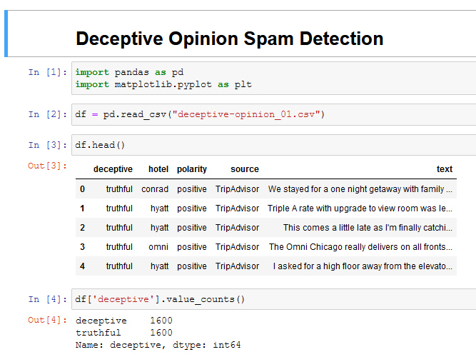
Data-Preprocessing:
The import of Libraries
such as Pandas and
matplotlib.pyplot
have made it easier and
convenient for the
model to function
The value count of
column ‘deceptive’
are equal, between
two values; deceptive
and truthful.

Slide 19
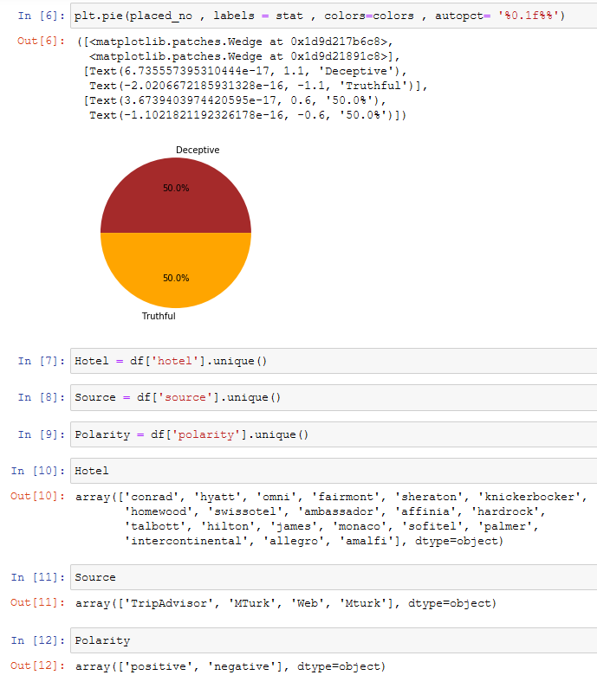
Using pie-representation
it is made clear that the
data is equally distributed.
Unique Values describe
the unique entries of
certain columns.

Slide 20
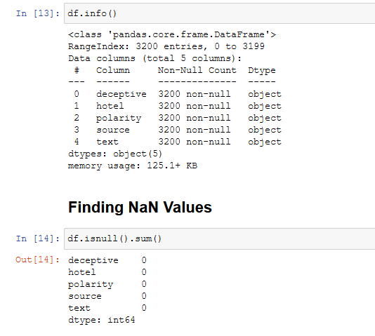
The basic information is
provided by using df.info()
which describes the entries
in al the columns as object(1).
(1)

Slide 21
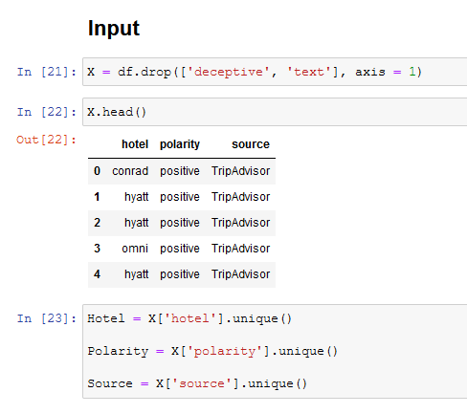
Input and Output
As the next step is breaking
the dataset into Input(X) and
Output(y);
We need to drop a few
irrelevant columns, here
‘deceptive’ and ‘text’.

Slide 22
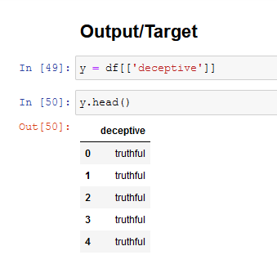
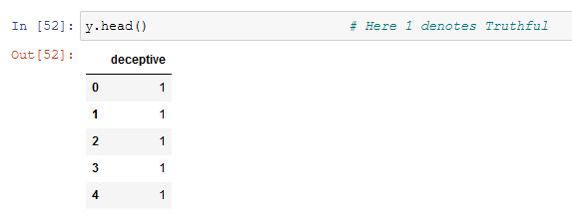
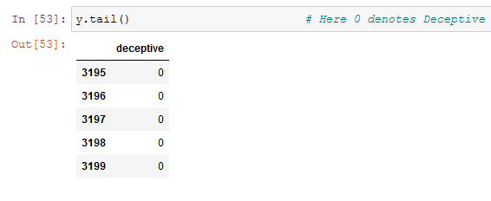
(3)
(2)
Output consists of only deceptive
column (2)
1 denotes Truthful (3)
0 denotes Deceptive (4)
(4)

Slide 23
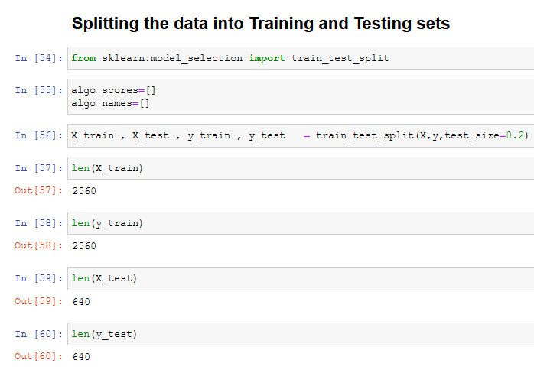
Splitting x and y in training and testing data
The splitting of data into
training and testing
sets requires library(5).
Calculation of length
of test and train splits
provides with
precision(6).
(5)
(6)

Slide 24
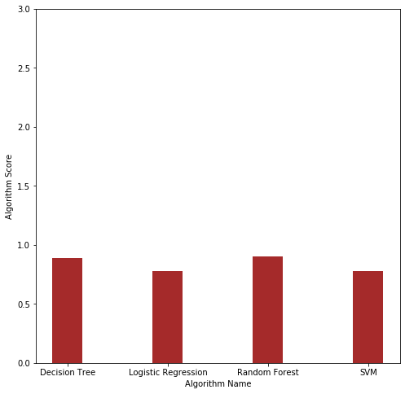
COMPARING THE CLASSIFICATION SCORE OF DIFFERENT ALGORITHMS USING BAR GRAPH
Random Forest and Decision
Tree have the same accuracy
whereas the Logistic
Regression and SVM show
similar accuracy.

Slide 25
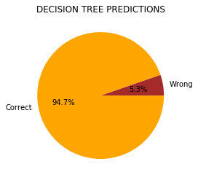
Individual Prediction Depiction of Models
1. Decision Tree
The % of correct prediction
is 94.7% and for wrong
prediction it is 5.3%.
5% of X_test, score*X_test)
was used in order to depict
this representation.

Slide 26
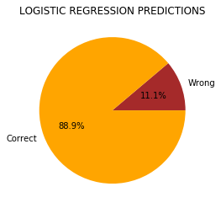
2. Logistic Regression
The % of correct prediction
is 88.9% and for wrong
prediction it is 11.1%.
10% of X_test, score*X_test)
was used in order to depict
this representation.

Slide 27
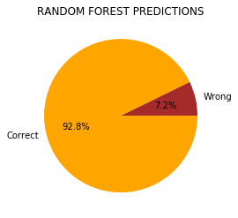
3. Random Forest
The % of correct prediction
is 92.8% and for wrong
prediction it is 7.2%.
7% of X_test, score*X_test)
was used in order to depict
this representation.

Slide 28
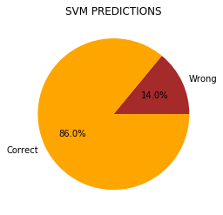
4. Support Vector Machine
The % of correct prediction
is 86.0% and for wrong
prediction it is 14.0%.
13% of X_test, score*X_test)
was used in order to depict
this representation.

Slide 29

Conclusion
BASED ON PRECISION , PREDICTION PIE CHART, WE CAN SAY THAT RANDOM FOREST CLASSIFICATION AND DECISION FOREST CLASSIFICATION IS BEST SUITED FOR THIS PROBLEM WHERE WE ARE PREDICTING WHETHER THE TEXTS TO VARIOUS HOTELS THROUGH VARIOUS SOURCES ARE DECEPTIVE OR TRUTHFUL.

Slide 30
References:
https://www.kaggle.com/
https://www.geeksforgeeks.org/
https://sci-hub.tw/

